Slide 1

NLPR Report

Slide 2
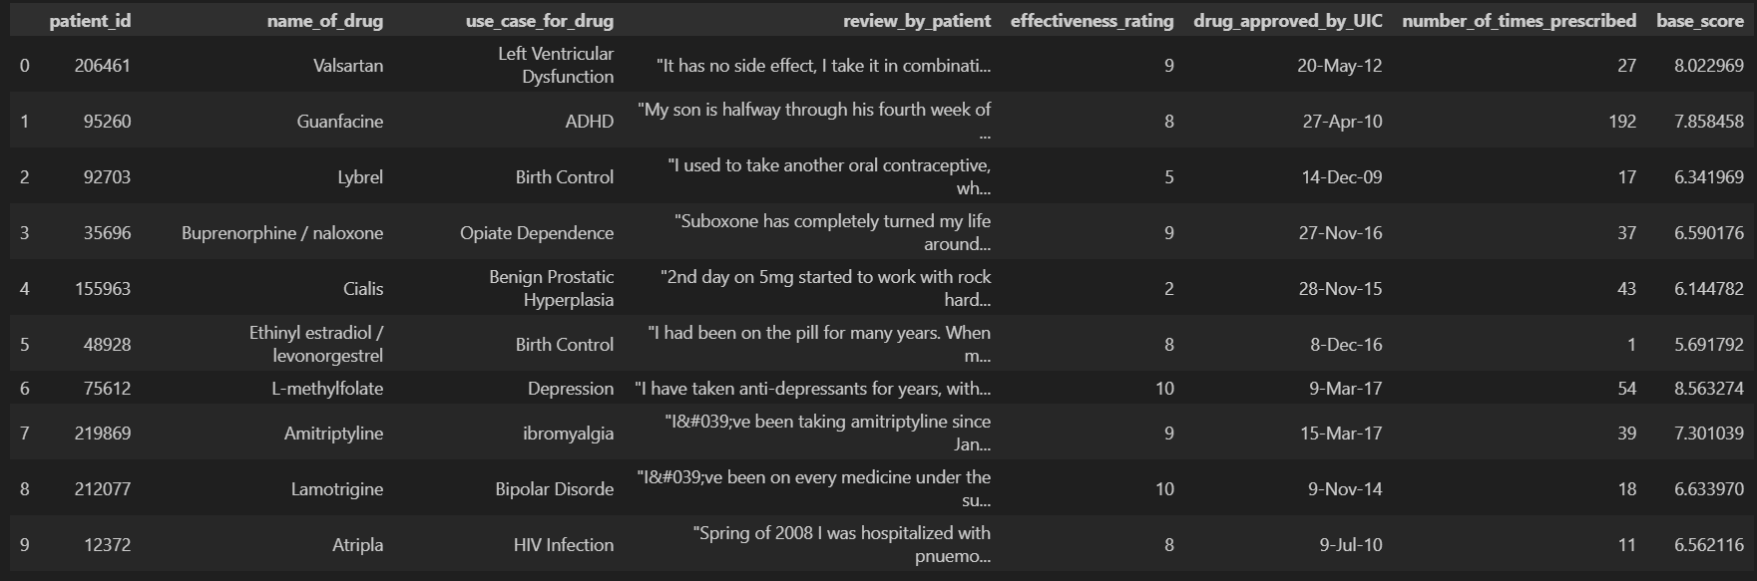
Dataset
For the text classification task, I used the Druggie dataset

Slide 3
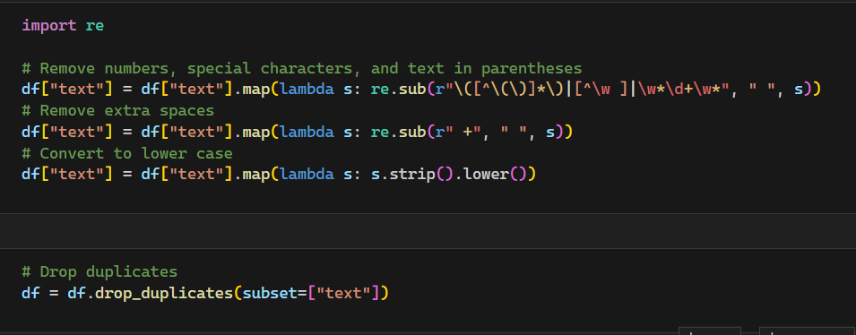
Data Cleaning
Special characters and numbers were removed
Consecutive spaces were replaced with a single space
Text was normalised to all lower case
No missing values were identified

Slide 4
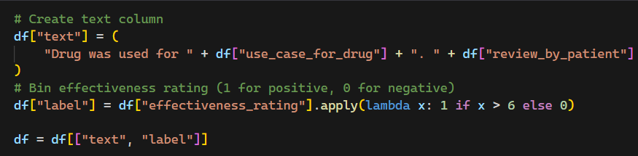
Data Transformation
The use case was included along with the review to provide more context
The rating was binned to transform the regression problem into a classification problem

Slide 5
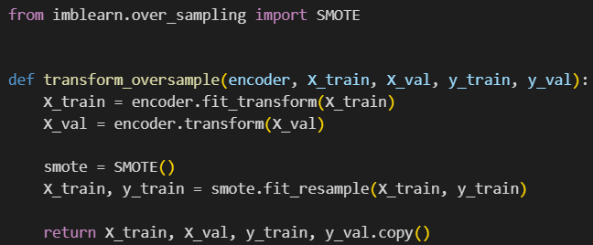
Data Augmentation
Data augmentation was performed as the dataset was unbalanced (roughly 2:1 ratio)
As SMOTE only works on continuous data, it is only used later on the vectorised data

Slide 6
Model Performance
Model | Base Accuracy (%) | Hypertuned Accucary* (%)
Logistic Regression | 76.0 | 76.3
Naive Bayes | 75.2 | 75.7
Support Vector Machine | 77.8 | 77.8
FastText | 80.9 | -
LSTM | 80.7 | -
BERT (Transformer) | 86.2 | -
*Some models could not by hypertuned due to limitations of the library’s API or a lack of computational resources (Google Collab usage limits)

Slide 7
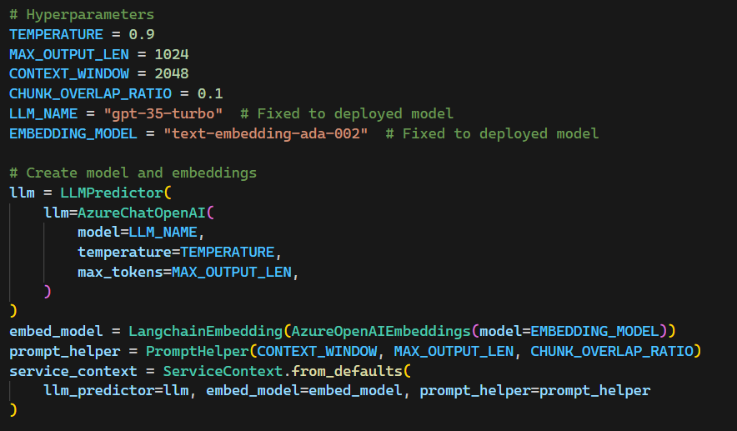
LLM
After some hypertuning, I arrived at these hyperparameters

Slide 8
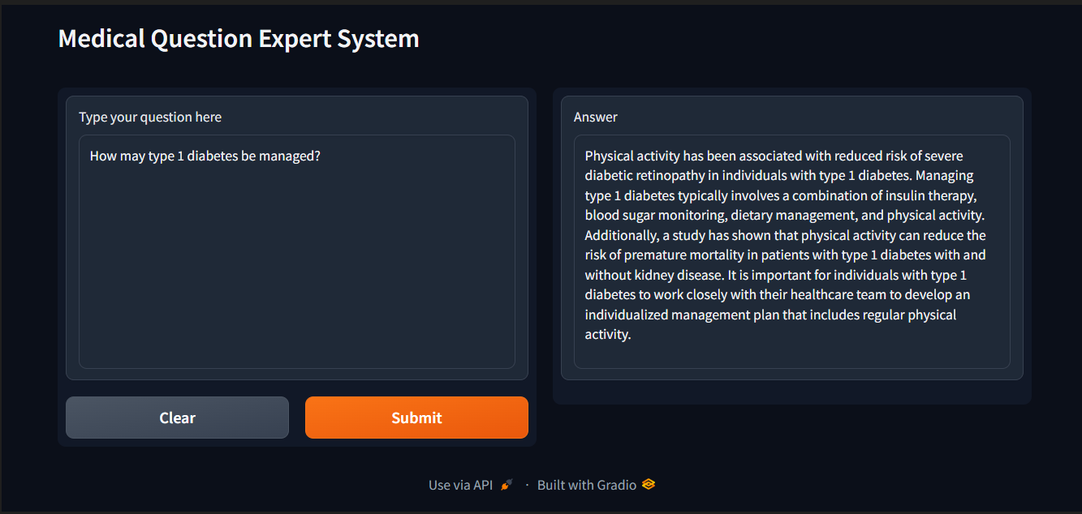
LLM Sample Answer

Slide 9
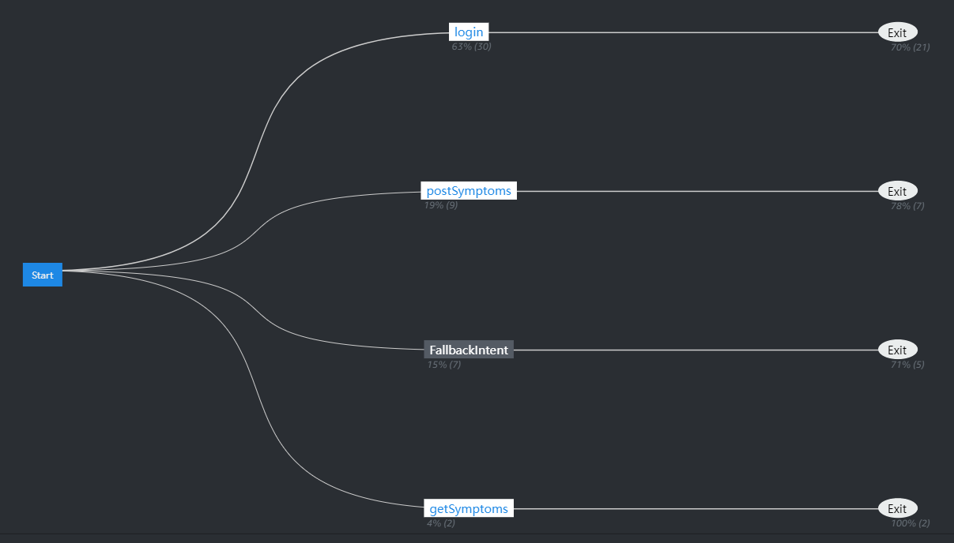
Lex Chatbot
A chatbot with the necessary intents was created

Slide 10
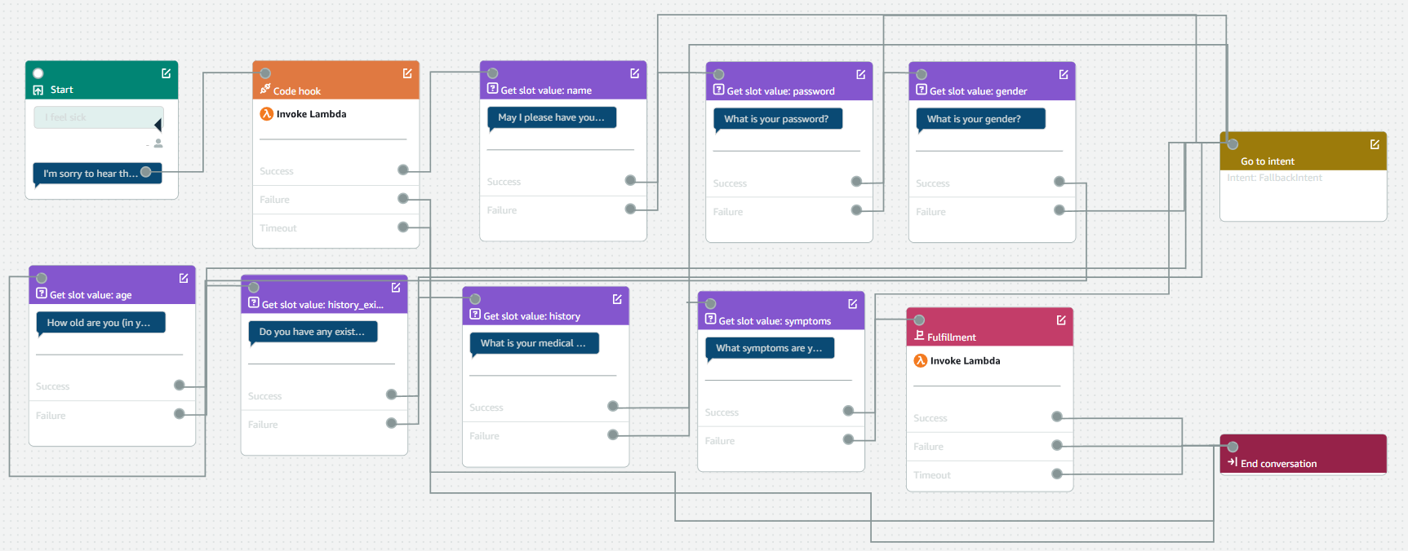
Lex Chatbot
Smooth conversation flows and appropriate slots were created for each intent

Slide 11
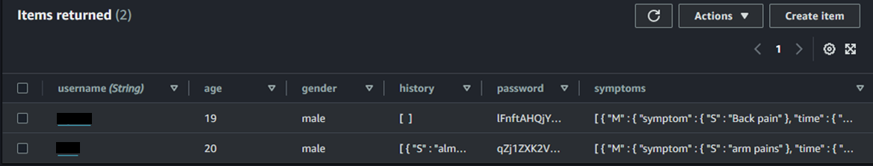
User Database
A DynamoDB table was created to store all the user data
The passwords are hashed with 100,000 rounds of sha-512 for robust security

Slide 12
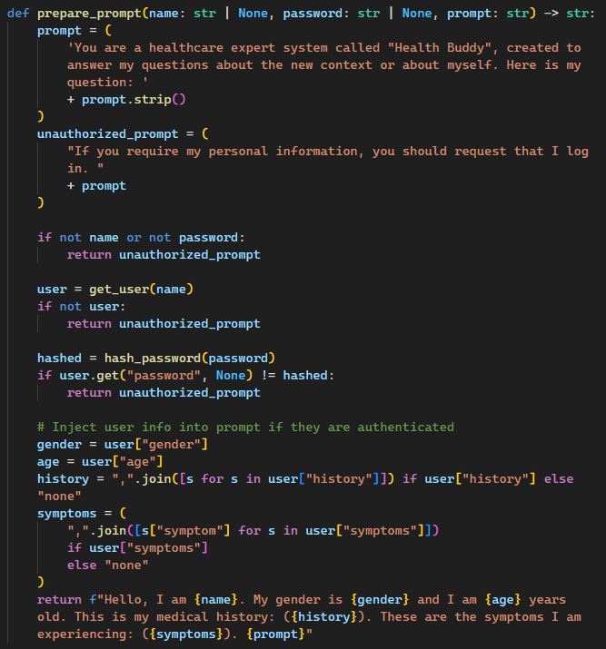
Integrating LLM into Lex
A specially crafted prompt template was created to make the LLM’s responses more seamless and relevant

Slide 13
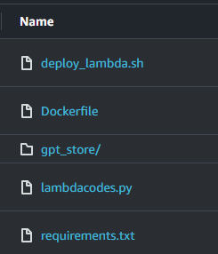
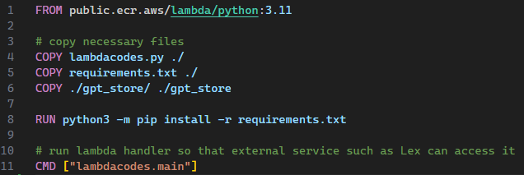
Integrating LLM into Lex
The lambda handler code and LLM environment were dockerized and deployed to AWS ECR

Slide 14
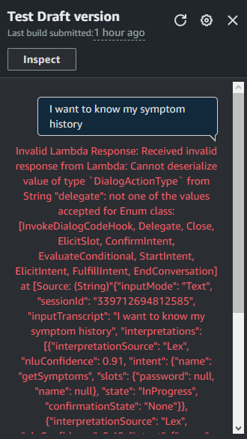
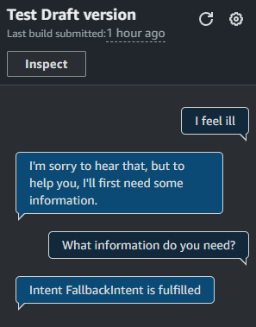
Debugging Lex
Pain, lots and lots of pain...
The lambda handler crashed, causing Lex to close the intent pre-maturely
“Delegate” was misspelled as “delegate”

Slide 15
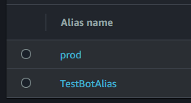
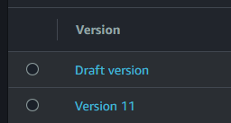
Deploying Lex
The chatbot was properly versioned and used multiple aliases. This makes CI/CD easy without breaking the production version of the chatbot during development.

Slide 16
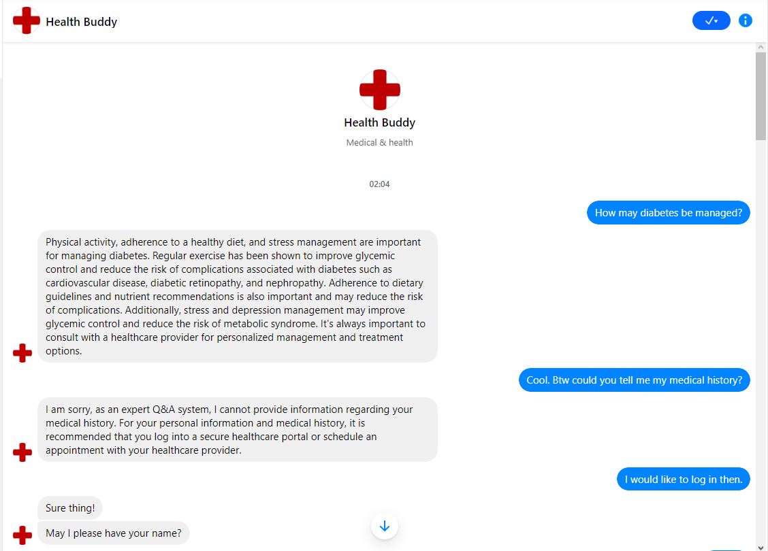
Deploying Lex (Facebook Messenger)

Slide 17
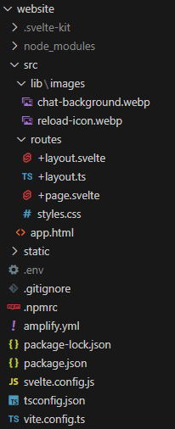
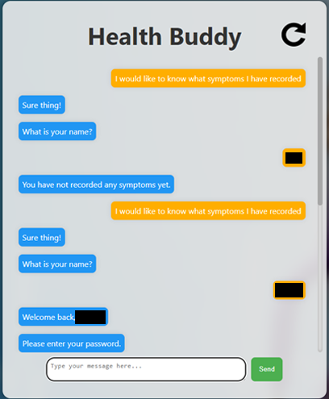
Deploying Lex (Website)
A website was created using Svelte
Hosted serverlessly via Amplify

Slide 18
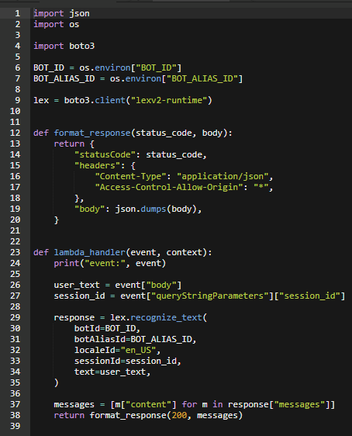
Deploying Lex (Website Backend)
A lambda function was used to wrap the chatbot in a REST API that could be called externally

Slide 19
Solution Analysis
My current solution uses only 3 PDFs on specific topics to provide context to the LLM, and as a result, the LLM refuses to answer many medical questions as they are outside the scope of the provided context.
The user’s username and password are cached in the session’s attributes, meaning that the user only has to log in once per session. This increases convenience while maintaining security.
The chatbot is deployed to Facebook messenger, granting greater convenience and ease of use to most users. It is also deployed to my own website, which provides extra features like resetting the current session.

Slide 20
Future Improvements
More PDFs on more diverse medical topics can be fed into the LLM, and a better prompt can be engineered to make the LLM refuse to answer less often
The chatbot’s lambda handler can be versioned to prevent breaking production during development cycles
A salt can be generated for each user and used to further secure user passwords by preventing rainbow table attacks
As not many young people use Messenger, the chatbot can be deployed to more platforms such as Slack or Discord, increasing the outreach and prevalence of the chatbot

Slide 21
Appendix
Background used for website: https://wallpaperaccess.com/health-care
Favicon used for website: http://www.clker.com/clipart-red-medical-cross.html

